Slide 1

Spécifications
CREATION DE LA DESCRIPTION
A
D
SYNTHESE
B
E
PLACE & ROUTE
C
F

Slide 2
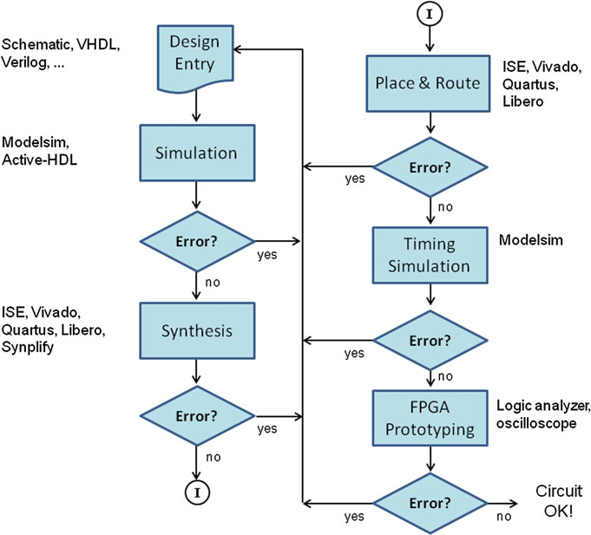
C
A
D
B
E

